Slide 1
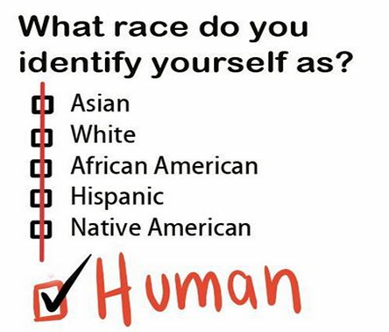
A level Sociology
Instructions
You need to work through the booklet and complete all tasks 1- 8. You need to bring a printed copy of this to our first lesson in September.
We follow the AQA A-level specification
If you have any questions email:
n.smith2@SCAcademy.co.uk OR h.cole@SCAcademy.co.uk

Slide 2
Topics we Cover:
Family | Education | Theory & Methods | Beliefs | Crime
Theories Functionalism Marxism Feminism Personal Life Postmodernism Govt Policies | Perspectives Functionalism New Right Marxism Feminism Social Democratic Interactionism Postmodernism incl types of sch | Perspectives Functionalism Marxism Feminisms Postmodernism Social Action | Theories Ideology & Science Beliefs Systems Functionalism Marxism Feminism Postmodernism | Theories Functionalism Marxism & Neo-Marxism Interactionism Control Theory Realist Theory Postmodernism
Diversity: Marriage Divorce Cohabitation Child Bearing Types of Diversity Life Course | Relationships & Processes Organisation of teaching and learning Labelling Subcultures Teachers and curriculum | Sources and Types of Data Quantitative / Qualitative Primary / Secondary Social Surveys Interviews Observations Experiments Official Statistics Qualitative secondary sources | Social Change and Stability Functionalism Marxism Weber Feminism Fundamentalism | Social Distribution Statistics Gender Ethnicity Locality Social Class
Changing Roles Gender Roles Domestic Division of Labour Decision making Power Relations Domestic Violence | Differential Achievement Social Class Gender Ethnicity | Research Design Practical Considerations Ethics Theoretical Considerations | Religious Organisations Typologies New Religious Movements New Age Movements Reasons for joining NRM & NAM | Globalisation Globalisation Mass Media Green Crime State Crime
Childhood Social Construction State of Childhood Future of Childhood | Educational Policies Early Policy Tripartite system Comprehensivisation Marketisation Recent Policies | Sampling Random Systematic Stratified Quota Snowball | Social Groups and Religion Gender Ethnicity Age Social Class | Control and Prevention Right Realism Left Realism Punishment CJS Prisons Victimology
Demographics Birth Rates Infant Mortality Death Rate Life Expectancy Aging Population Family Size Migration |  | Debates Factors affecting research Interpretivism V Positivism Value Freedom Sociology as a Science Sociology and Social policy. | Significance of Religion Globalisation Spiritual Shopping Secularisation Religious Significance

Slide 3
Sociology is…
The study of society, large groups of people and individuals
A study of how and why people behave the way they do in society
Looking at how structures such as family and government influence human behaviour
A social science which uses research to investigate and predict human behaviour to help governments improve the lives of its citizens
A critical and radical subject, it is about questioning why society is as it is. It is about digging under the surface, looking at what is really going on.
Is sociology for me?
Yes, if you’re interested in questions like these…
Are children and young people treated unfairly in society?
Why are some people rich and some people poor?
Are people successful because of their background or how hard they work?
Why are some of the hardest jobs poorly paid?
Why are a large proportion of MPs white, male and from private schools?
Would the world be happier if there was just one religion?
Sociology is NOT...
An easy subject
Just common sense
Wishy-washy and unscientific
Psychology

Slide 4
Assessment in Sociology
There is no coursework in Sociology all assessment is exam based and these are sat at the end of Year 13.
We focus particularly on how certain features of a person’s social position (i.e. their gender, social class and ethnicity) might affect their LIFE CHANCES in society.
Sociology is regarded as a Social Science, largely because it uses a number of research methods to examine society in more detail.
A major part of gaining success in Sociology is by learning the main ideas, concepts and terms used – the language of the subject – and then being able to use this language when you are discussing the topics and issues relevant to the study of society.
Examinations
Students sit 3 examinations
Each examination is 2 hours
Paper One: | Paper Two: | Paper Three:
Education Methods in Context Theory and Methods - 33% of A Level | Families Beliefs in Society - 33% of A Level | Crime and Deviance Theory and Methods - 33% of A Level

Slide 5
What kind of Sociologist will you be?
1. The defining characteristic of human behaviour is:
A) Their gender/ sex
B) Their social class
C)Their Race
D) Their integration into society
E) Their culture
2. We have the freedom to choose our own behaviour
A) Yes
B) No
C) Depends
D) Doesn’t matter
E) What is freedom?
3. What are your views on the family….
A) Family is oppressive to women and teaches us to conform to gender roles
B) Family is a tool of the ruling class teaching us to obey authority
C) Family is a vital part of socialisation that teaches us norms and values
D) Family is what you make it, everyone has a different view on it
E) Family – what is a family? You can’t define it
4. When it comes to inequality..
Gender is the most serious issue!
Money and power the rich exploit the poor!
Inequality is normal part of society
Inequality is a label that has different meanings to people
You make your own reality up
5. When it comes to crime …..
The justice system is more lenient on women
Criminal laws protect the rich and powerful
Crime is good for society as it reminds us of the rules
Crimes are actions labelled as wrong to influence our behaviour
Crime – what is a crime? Can we really define what a crime is?
6. When it comes to religion...
Religion oppresses and controls women – telling us to cover up and be obedient
Religion is a tool used by those with power to control us
Religion is a useful institution which unites people who share a common set of beliefs
Religion means different things to different people
Religion is just another meta-narrative (big story) people use to explain reality

Slide 6
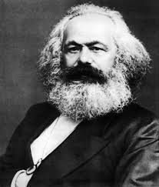
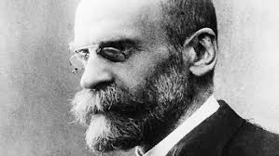
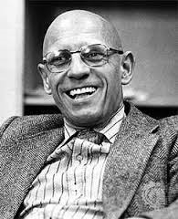
What kind of Sociologist will you be?
Mostly A – Our Feminist
You are most likely to turn into our Feminist Sue Sharpe. Feminism looks at how society is structured in a way that benefits men while oppressing women – this is known as patriarchy (male domination.). The theory is often a misunderstood as stereotypes and misconceptions about it exists. Many people do not realise that there are several types of feminism such as black, radical feminism and liberal.
Mostly B – Our Marxist
You are most likely to turn into Karl Marx. Marxism looks at how society is constructed is a way that produces class conflict with the rich having all the power and control whilst the poor are oppressed. Marx argues that the root cause of class inequality is down to capitalism as it encourages people to be greedy and materialistic. Just as capitalism replaced feudalism, Marx argues that capitalism will one day be replaced with communism
Mostly C- Our Functionalist
You are most likely to turn into Emile Durkheim. Functionalism is theory which argues that members of society are united together by a shared set of idea and beliefs called ‘norms’ (normal behaviour.) These norms are accepted by all members in society and are enforced by structures such as family and education. They see society like a human body – with all parts needed in order for it to ‘function’ and work effectively.
Mostly D- Our interactionist
You are most likely to turn into Becker/ Mead. Interactionism looks at how people create meaning during social interactions, how they present and construct the self (or identity) as well as how they define situations. One of the perspectives key ideas is that people act the way they do because of how they define situations. Becker uses the example of nudity to illustrate how timing, place and audience can influence how people see an action or idea.
Mostly E – Our post-modernist
You are most likely to turn into Foucault. Post-modernism is a more recent Sociological theory which seeks to question and de-construct existing structures and understandings of reality. Post modernism rejects the idea that one theory such as functionalism, Utilitarianism, religion or even science can explain reality!

Slide 7
Theory is a big part of sociology
Task 1: Functionalism
Find definitions for free will and determinism, now write your own definitions for these terms
Research functionalism and produce a fact sheet outlining the functions perspective ensuring you use the following terms:
consensus
organic analogy
socialisation
norms
values
social solidarity
Write two paragraphs one on the strengths on the theory and another on the limitations

Slide 8
Task 2 - Feminism
Research Feminism and produce a fact sheet outlining the definitions and provide examples. Research examples of gender inequality within the UK today. Present your findings is a suitable format.

Slide 9
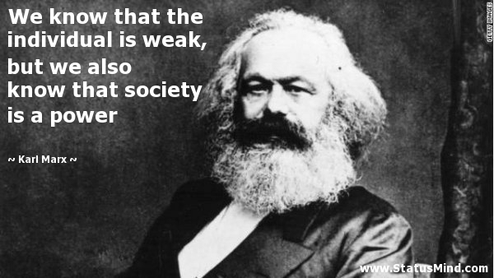
Task 3 - Marxists
Watch YouTube clip: https://www.youtube.com/watch?v=Vz3eOb6Yl1s
Define each of the key words used in the video Research Marxism and produce a factsheet outlining the difference between the bourgeoisie and the proletariat. Research examples of class inequality within the UK in contemporary society. Choose one of the examples and explain how a Marxist would interpret the situation How would a functionalist counter this approach?

Slide 10
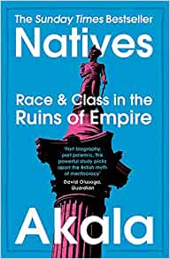
Reading linked to Sociology
A Glasgow Gang Observed by James Patrick
Gang Leader for a Day by Sudhir Venkatesh
Chavs by Owen Jones
Eve Was Shamed by Helena Kennedy
Savage Girls and Wild Boys by Michael Newton
Natives by Akala
I am Malala by Malala Yousafzai
The New Jim Crow by Michelle Alexander
The McDonaldization of Society by George Ritzer
To Kill a Mocking Bird by Harper Lee
Why I'm No Longer Talking About Race by Reni Eddo-Lodge
Living Dolls by Natasha Walter

Slide 11
Useful resources
To help you on your way…
It is also recommended that you take an active interest in the news and what is going on around you in the wider world as a lot of the concepts and ideas covered in lessons will relate to what is going on. The ability to be able to draw upon contemporary examples will also help illustrate your application and understanding skills which will be vital in order for you to achieve the higher grades in this subject.
Suggested Textbooks
Aiken, Chapman, Holborn & Moore (2015) AQA A level Sociology Student Book 1: Collins
ISBN 13: 9780007597475
Browne, K (2015) Sociology for AQA: Volume 1: AS and 1st-Year A Level: Polity
ISBN 78-0745691305
Webb, Westergaard, Trobe & Townend, QA A Level Sociology Book One Including AS Level: Book 1, Napier Press
ISBN 9780954007911
Websites:
AQA New Specification – http://www.aqa.org.uk/subjects/sociology/as-and-a-level/sociology-7191-7192/introduction
AQA - Example Assessment Material -http://www.aqa.org.uk/subjects/sociology/as-and-a-level/sociology-7191-7192/assessment-resources
S-Cool Revision Materials - http://www.s-cool.co.uk/a-level/sociology
Every Day Sexism Project -http://everydaysexism.com/index.php/about
Who Needs Feminism - http://whoneedsfeminism.com/about.html
He for She Campaign - http://www.heforshe.org/
https://www.tutor2u.net/sociology/reference http://politybooks.com/kenbrowne/resources.asp
https://napierpress.com/book-one-workbooks
https://napierpress.com/book-two-workbooks
http://www.earlhamsociologypages.co.uk
https://www.sociologystuff.com

Slide 12
For your first lesson… We expect you to have the following:
A level arched folder – labelled with your name on and Sociology- you may wish to have separate folders for each teacher
Dividers
Lined paper
Plastic wallets if you want to use them
A pencil case with the usual things including highlighters and a green pen
This booklet and all the tasks you have completed.
Well done! You’re all set ready to embark on your Sociology A Level course.
We look forward to seeing you in September!

