Slide 1
Studying Psychology in 6th Form
This booklet is designed to introduce you to psychology at post 16 and some of the topics you will be studying.
Work through the booklet and complete the tasks.
You will need to have a copy of the tasks you have completed with you on your first lesson in September.
If you have any questions please contact:
Miss Smith: c.smith@scacademy.co.uk
Miss Newton: c.newton@scacademy.co.uk

Slide 2
What will I be studying?
Psychology is the scientific study of the mind and how it dictates and influences our behaviour. It is about understanding what makes people tick and how this understanding can help us address many of the problems and issues in society today. Psychology is dedicated to the study of human behaviour – and the thoughts, feelings and motivations behind it – through observation, measurement and testing, in order to form conclusions.
Year 12
Approaches Issues & debates Social Influence Attachment Memory Research Methods
Year 13
Biopsychology Psychopathology Schizophrenia* Relationships* Forensic psychology* *options are subject to change

Slide 3
Task 1: The History of Psychology
Psychology is a subject that is ever changing, with new research and areas of study emerging constantly. When you begin studying psychology it’s important to know where the subject came from, aswell as current developments.
Your first task is to create a timeline of the history of psychology. This can be done digitally or on paper.
Remember Psychology is a vast subject, so you do not need to include everything. Some ideas of what you could include are:
When psychology first began to be studied
Key psychologists and their theories/approaches
Key events/studies that were carried out
Interesting topics that are studied in psychology
This link is great to use as a starting point; however, you will need to conduct further research as it only gives a brief overview of the history.
https://allpsych.com/timeline/.
Be creative and make it look as interesting as possible, you can include pictures, colours, quotes, different materials and I’m sure you can think of many more!

Slide 4
Task 2: Approaches in psychology
Within Psychology there are 5 main approaches or perspectives to explain behavior.
Your second task is to research and produce a fact file on each of the psychological approaches. In each fact file you should include:
Assumptions of each approach i.e. how do they explain behavior/what causes human behavior?
Key psychologists that support each approach
Research methods that are used by each approach
Again your fact files can be digital, or paper based.
Psychodynamic approach
Behaviourist approach
Humanistic approach
Cognitive approach
Biological approach

Slide 5
Task 3: Psychology in the media
One of the most interesting things about studying Psychology is being able to apply what you have learnt in lessons to things outside of the classroom.
In your time off over the summer, whenever you watch, read or listen to any of the suggestions at the in this booklet (or any others that you find!) record it on the following page, with a summary of the content and your thoughts.

Slide 6
Babies
Brain on Fire
13 Reasons Why
The mind of Aaron Hernandez
Girl, interrupted
Fatherhood
Derren Brown:
The Push
Mindhunter
100 Humans
The Mind explained
Murder to mercy: The Cyntoia Brown story
Oprah Winfrey: When they see us now
Making a murderer
50 First Dates
Louis Theroux: A different brain
Eternal sunshine of the spotless mind
Recommended watching for studying Psychology

Slide 7
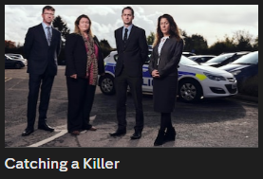
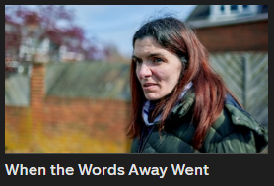
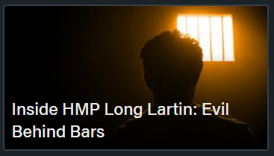
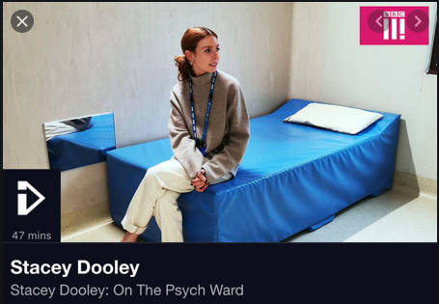
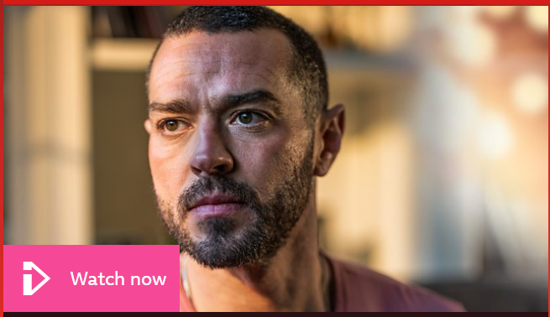
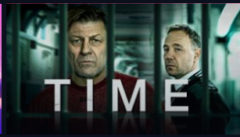
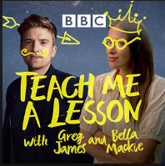
Beyond
Catching a killer
When the words went away
Inside HMP Long Lartin
4 On Demand
Channel 5
Stacey Dooley: on the psych ward
Matt Willis: Fighting addiction
Roman Kemp: Our silent emergency
BBC iPlayer
James Arthur: Out of our minds
Time
Teach me a lesson with Greg James and Bella Mackie – Episode 2 ‘Are people born evil?’
A Beautiful Mind
The Stanford Prison Experiment
Fear of Rain
Three Identical Strangers

Slide 8
Beyond
The prison doctor by Dr Amanda Brown
Room by Emma Donoghue
The killer across the table by John E. Douglas & Mark Olshaker
The Bell Jar by Sylvia Plath
The Shock of the Fall by Nathan Filer
The dark side of the mind by Kerry Daynes
Still Alice by Lisa Genova
The Psychopath test by Jon Ronson
The Skeleton Cupboard by Tanya Byron
Lord of the flies by William Golding
The Boy Who Couldn’t Stop Washing by Dr Judith Rapaport
Dear Evan Hansen by Val Emmich
Further Reading for Psychology

Slide 9
Summer learning log
Record here any additional reading/viewing you are undertaking in order to show what you have been completing to prepare you for the course. Use the recommendations on the previous pages for ideas of what to watch/read
Date | Title | Summary of content | My thoughts

Slide 10
Summer learning log
Record here any additional reading/viewing you are undertaking in order to show what you have been completing to prepare you for the course. Use the recommendations on the previous pages for ideas of what to watch/read
Date | Title | Summary of content | My thoughts

Slide 11
Useful resources
To help you on your way…
Websites:
AQA A Level New Specification – https://www.aqa.org.uk/subjects/psychology/as-and-a-level/psychology-7181-7182
BTEC national specification - https://qualifications.pearson.com/en/qualifications/btec-nationals/applied-psychology.html
Tutor2U - https://www.tutor2u.net/psychology
The British Psychological Society - https://www.bps.org.uk
It is also recommended that you take an active interest in the news and what is going on around you in the wider world as a lot of the concepts and ideas covered in lessons will relate to what is going on. The ability to be able to draw upon contemporary examples will also help illustrate your application and understanding skills which will be vital in order for you to achieve the higher grades in this subject.
For your first lesson you will need to have the following…..
A lever arch folder
A set of dividers
Your own lined paper
Plastic wallets if you want to use them
A pencil case with the usual things including highlighters and a green pen
A copy of this booklet and all the tasks you have completed
If you have any questions please get in contact with us via email.
We look forward to seeing you in September!

