Slide 1
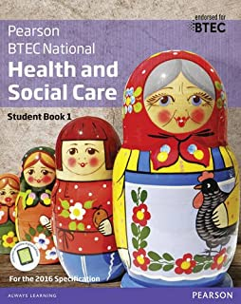
Level 3 BTEC National Diploma Health and Social Care
Instructions
You need to work through the booklet and complete all tasks. You need to bring a printed copy of this to our first lesson in September.
If you have any questions before September email:
c.smith@SCAcademy.co.uk
n.smith2@SCAcademy.co.uk
c.newton@SCAcademy.co.uk

Slide 2
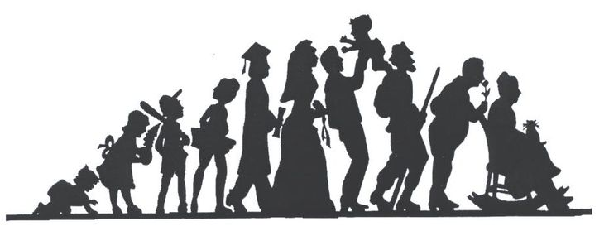
Contents
What will I be studying? Page 3
Recommended Netflix Programmes Page 4
Other recommended watching Page 5
Recommended Reading Page 6
Representations Task Page 8
Learning Log Page 9
Key word Glossary Page 10 - 11
History of the NHS Page 12
Roles in Health and Social Care Page 13
Frontline roles in a pandemic Page 14 - 15
Checklist for September Page 17

Slide 3
What will I be studying?
This course allows you an insight in the many roles available within health and social care from nurses to social workers to child care assistants and beyond they have many key features that we shall explore and apply.
You will be studying a range of units which will help you to gain skills that will be valuable in your chosen profession or future study. You will learn about the human body and mind alongside the changes across time. You will learn what it means to work in the sector and what skills and behaviours you will need to develop. We will study the following units although you may not study them in this order.

Slide 4
What will I be studying?

Slide 5
Babies
Marriage Story
Louis Theroux: Extreme love, Dementia
Five Feet Apart
Brain on Fire
Theory of Everything
What to expect when you’re expecting
Unbroken
Girl, interrupted
Call the Midwife
13 Reasons Why
Pandemic: How to prevent an outbreak
Recommended Watching for Health and Social Care

Slide 6
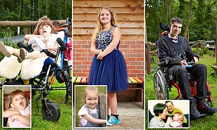
Beyond
This is Going to Hurt
Rio & Kate: Becoming a Step family
Jesy Nelson: Odd one out
Bohemian Rhapsody
BBC iPlayer
DVD
24 Hours in A&E
Born to be different
Secret life of… Year Olds
Still Alice
4 On Demand
DVD
The Children Act
The Upside
Beautiful Boy
Miss you Already
Amazon Prime

Slide 7
Recommended Reading for
Health and Social Care
Pig Heart Boy by Malorie Blackman
Wonder by R.J. Palacio
This is Going to Hurt by Adam Kay
When Breathe becomes Air by Paul Kalanithi
The Hate U Give by Angie Thomas
Me Before you by Jojo Moyes
The Fault in Our Stars by John Green
The Story of Baby P by Ray James
Savage Girls and Wild Boys by Michael Newton
The Language of Kindness by Christie Watson
I am Malala by Malala Yousafzai
The Boy Who Couldn’t Stop Washing by Dr Judith Rapaport

Slide 8
Learning Log
Record here any additional reading/viewing you are undertaking in order to show what you have been completing in order to prepare you for the course.
Date | Title | Summary of content | My thoughts

Slide 9
Task: Research the following words which are central to the study of Unit 1, explain the meaning of each in your own words.
Term | Definition
Adolescence | An important status change following the onset of puberty during which a young person develops from a child into a adult.
Attachment
Development
Developmental norms
Fine Motor Skills
Gross Motor Skills
Growth
Menopause
Milestone
Nature

Slide 10
Term | Definition
Negative Reinforcement
Nurture
Parallel Play
Positive Reinforcement
Self-Concept
Self-Esteem
Stranger Anxiety
Susceptibility

Slide 11
Life stages
Physical growth and development continues throughout a person’s life but development is not always smooth. In unit 1 students will study the key feature of physical growth and development across the life stages.
Students need to the learn the specific names and age ranges for each of the life stages.
Students will complete exam questions on these in September – be prepared!
Life stage | Age range
Infancy | 0-2 years
Early childhood | 3-8 years
Adolescence | 9-18 years
Early Adulthood | 19-45 years
Middle Adulthood | 46-65 years
Later Adulthood | 65+

Slide 12
Research Tasks
In unit 1 students will study about puberty, the menopause an osteoarthritis, in preparation for this students are required to research each of these and provide a summary of each. Further guidance of what needs to be included is outlined below.
Summaries should be in students own words and can include pictures/diagrams where appropriate.
Puberty
Your research needs to include the following:
An overview of what puberty is
The ages at which this occurs for both males and females
Definitions of primary sexual characteristics and secondary sexual characteristics
An overview the primary and secondary sexual characteristics for both males and females
Definition of sexual maturity
The role of hormones in sexual maturity consider both testosterone and oestrogen
Menopause
Your research needs to include the following:
An overview of what the menopause is
The age at which this occurs
How long it takes to complete the menopause
The physical effects of the menopause
The emotional effects of the menopause
Osteoarthritis
Your research needs to include the following:
An overview of what osteoarthritis is
Risk factors – who is more likely to develop the condition? When?
Physical changes caused by the condition
The difference between osteoarthritis and osteoporosis

Slide 13
Sixth Form Tasks Checklist
Use this list to make sure you have completed everything.
Complete at least 6 sections of the learning log, page 8.
Completed glossary of key terms, pages 9- 10.
Learnt the names and age ranges for each of the life stages, page 11
Research tasks on puberty, menopause and osteoarthritis, page 12 .

Slide 14
In September..
Ready for your first lesson in September you need to ensure you have:
A large Lever Arch Folder – labelled with your name and Health and Social Care
A set of dividers for your folder
A pencil case with the usual pens and pencils ideally with highlighters and a green pen
Plastic wallets if you wish to use them
A completed copy of this booklet, this can be handwritten or typed (an electronic copy will be emailed out)

