Slide 1
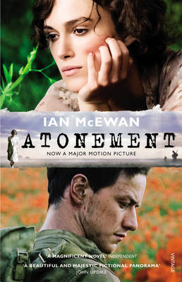
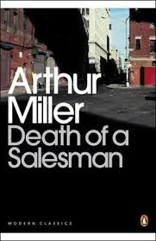
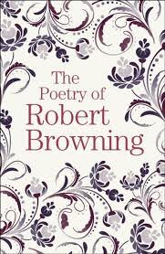
A Level English Literature
You need to work through this booklet and complete all tasks. Bring a printed copy of this to our first lesson in September.

Slide 2
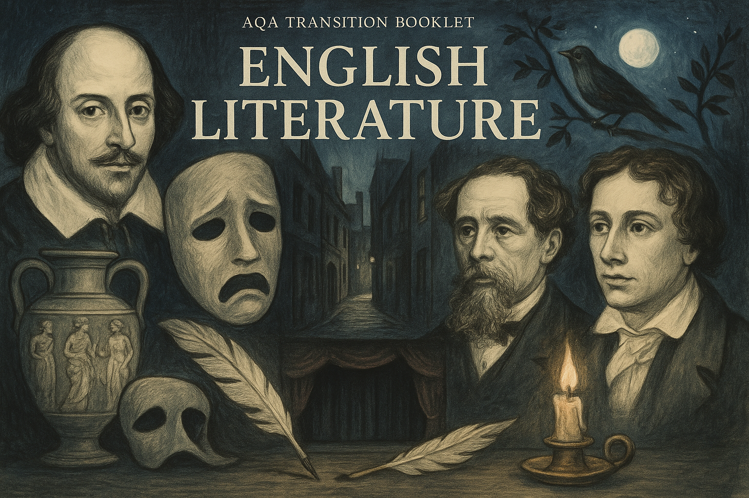
Contents
What will I be studying?
Page 3
Glossary of literary key terms
Page 4
Aspects of Tragedy: Research task
Page 5
Recommended Reading: Tragedy
Page 6
Aspects of Crime: Research task
Page 7
Recommended Reading: Crime
Page 8
In September...
Page 9

Slide 3
What will I be studying?
Studying English Literature will allow you to step into other worlds, explore timeless ideas, and discover the power of language to move, challenge, and inspire us.
In this subject, you’ll meet unforgettable characters, tackle the big questions, and uncover the deeper meanings behind some of the greatest works ever written. From the haunting streets of Dickensian London to the poetic beauty of Keats’ Romantic verse, and the dramatic intensity of Shakespeare’s stage, English Literature invites you to think critically, feel deeply, and express yourself with clarity and confidence.
Paper 1 - Literary Genres Aspects of Tragedy Texts are: Othello by Shakespeare Death of a Salesman by Arthur Miller Keats poetry (selection) Examination | Paper 2 – Texts and Genres Elements of Crime Writing Texts are: Oliver Twist by Dickens Atonement by Ian McEwan Crime poetry (selection) Examination | NEA – Non-Exam Assessment Theory and Independence Critical theory NEA: Prose – 1,500 word essay Poetry – 1,500 word essay Your choice

Slide 4
Task: Find definitions of each of the literary terms below and create a glossary containing the terms and their meanings.
The glossary you create can be a reference document to be used later, so make sure it is well presented and clearly set out.
ALLEGORY | ANTAGONIST | ANTHROPOMOPHIC
ANTI-HERO | ARCHAIC | ASIDE
AUTODIEGETIC NARRATOR | BALLAD | BATHOS
BLANK VERSE | CATHARSIS | CONTEXT
DEBATE | DECLARATIVE | DENOUEMENT
DIVINE RIGHT | DRAMATIC MONOLOGUE | ENJAMBEMENT
EXCLAMATORY | FATE | FOCALISED NARRATIVE
GENRE | HAMARTIA | HETERODIEGETIC NARRATOR
HOMODIEGETIC NARRATOR | HUBRIS | IAMBIC PENTAMETER
IDEOLOGY | IMPERATIVE | INTRADIEGETIC
INTERROGATIVE | METAPHOR | METRE
MOTIFS | NARRATIVE | OMNISCIENT
PATHOS | PERSONIFICATION | PRIMOGENITURE
PRONOUN | PROSE | PROTAGONIST
SEMIOTICS | SOLILOQUY | STICHMOYTHIA
SYMBOLISM

Slide 5
Aspects of Tragedy
Research Task:
Choose one of Shakespeare's tragedies from the list below (avoid Othello) and conduct some research to help you apply the elements of Shakespearean tragedy to the play.
Who is the tragic hero?
What tragic flaws do they possess and how are they shown to the audience?
What events occur to fulfil the five-part tragic structure?
How does the tragic hero experience external and internal conflict?
Where are their elements of the abnormal/supernatural/fate/fortune and chance?
You can present your ideas as notes or a mind-map.
Shakespeare’s tragedies:
- Antony and Cleopatra
- Coriolanus
- Hamlet
- Julius Caesar
- Macbeth
- King Lear
- Romeo and Juliet
- Timon of Athens

Slide 6
Recommended Reading: Tragedy
To further broaden your appreciation of the genre of tragedy you may also wish to complete some wider reading.
Below is a reading list which offers a range of tragedies that span different time periods, cultures and themes.
These texts are not compulsory, but you may find them helpful in widening your understanding of the genre of tragedy.
Aristotle- Poetics
Jay Asher- Thirteen Reasons Why
Emily Bronte- Wuthering Heights
Thomas Hardy- Tess of the D’Urbervilles *
Khaled Hosseini- The Kite Runner/ A Thousand Splendid Suns
Henrik Ibsen- A Doll’s House
Kazuo Ishiguro- The Remains of the Day *
Audrey Niffenegger- The Time Traveler’s Wife
Sylvia Plath- The Bell Jar
Arundhati Roy- The God of Small Things
Jonathan Safran Foer- Extremely Loud and Incredibly Close
Alice Sebold- The Lovely Bones
Mary Shelley- Frankenstein
Tennessee Williams- A Streetcar Named Desire *
Markus Zusak- The Book Thief
*also featured on this course, but not studied by us

Slide 7
Aspects of Crime
Research Task:
Research different types of crime fiction and key elements of crime writing. What different types can you find? What kind of writers would you associate with each type?
You can present your research as notes, a mind-map or timeline
You may wish to include:
What are the key features of crime writing? (E.g. typical plot structures, characters, settings, themes)
How has crime fiction changed over time? Choose two time periods or subgenres (e.g. Victorian detective fiction vs. modern psychological thrillers) and compare them.
Who are some famous crime writers or texts? Mention at least two authors (e.g., Agatha Christie, Arthur Conan Doyle, Patricia Highsmith) and explain their influence on the genre.
What makes a criminal or a victim compelling in literature? Reflect on how writers present moral ambiguity, sympathy, or complexity in these roles.
What questions do crime texts ask about society or justice? Consider how crime writing can be used to critique social issues.

Slide 8
Recommended Reading: Crime
To further broaden your appreciation of the genre of crime writing you may also wish to complete some wider reading.
Below is a reading list which offers a range of crime texts that span different time periods, cultures and themes.
These texts are not compulsory, but you may find them helpful in widening your understanding of the genre of crime.
Kate Atkinson – When Will There Be Good News*
John Buchan – The Thirty-Nine Steps
Raymond Chandler – The Big Sleep
Agatha Christie – Murder on the Orient Express etc.
Sir Arthur Conan Doyle – Sherlock Holmes stories
Daphne Du Maurier – Rebecca
Ian Fleming – Casino Royale, James Bond novels
Gillian Flynn – Gone Girl/Sharp Objects/Dark Places
John Grisham – The Client, The Firm, The Street Lawyer, The Runaway Jury
Mark Haddon – The Curious Incident of the Dog in the Night-Time
Thomas Harris – Red Dragon, The Silence of the Lambs, etc.
Ian McEwan – Enduring Love, The Cement Garden
*also featured on this course, but not studied by us

Slide 9
In September..
Ready for your first lesson in September you need to ensure you have:
A large Lever Arch Folder – labelled with your name and English Literature
A set of dividers for your folder
A pencil case with the usual pens and pencils ideally with highlighters and a green pen
Plastic wallets if you wish to use them
A completed copy of this booklet, this can be handwritten or typed (an electronic copy will be emailed out)

