Slide 1
A Level English Language
You need to work through this booklet and complete all tasks. Bring a printed copy of this to our first lesson in September.

Slide 2
Contents
What will I be studying?
Page 3
Glossary of language key terms
Page 4
Research: Key Theorists
Page 5
Research: Media Institutions
Page 6
Language Frameworks
Page 7
Recommended Reading
Page 8
In September...
Page 9

Slide 3
What will I be studying?
English Language is a fascinating and thought-provoking course that will transform the way you think about language. It’s not just about reading and writing — it’s about analysing how language works in the real world, exploring how it reflects our identities, and understanding how it evolves over time.
In this course, you’ll investigate contexts — from political speeches to social media posts, from children’s early language development to the influence of technology on communication. You’ll become confident in analysing spoken and written texts, developing your ability to write clearly, critically, and creatively.
Paper 1 – Language, the Individual and Society Textual variations and representations Children's language development (0-11 years) Methods of language analysis are integrated into the activities Examination | Paper 2 – Language Diversity and Change Language diversity and change Language discourses Writing skills Methods of language analysis are integrated into the activities Examination | NEA – Non-Exam Assessment Language in Action Language Investigation Original Writing Methods of language analysis are integrated into the activities NEA: Students produce: a language investigation (2,000 words excluding data) a piece of original writing and commentary (1,500 words total)

Slide 4
Task: Find definitions of each of the language key terms and methods of language analysis below and create a glossary containing the terms and their meanings.
The glossary you create can be a reference document to be used later, so make sure it is well presented and clearly set out.
Lexis
Semantics
Syntax
Pragmatics
Discourse
Graphology
Phonology
Morphology
Mode
Idiolect

Slide 5
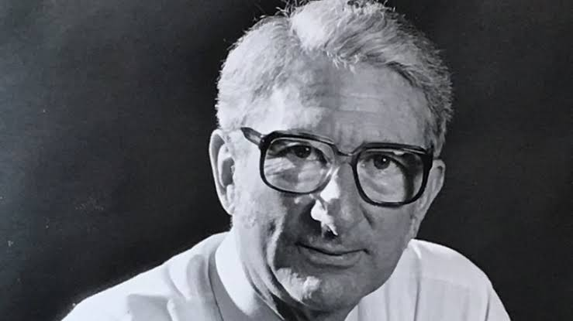
Research: Key Theorists
M.A.K. Halliday
Investigate the contributions of M.A.K. Halliday to the field of linguistics. Focus on his Systemic Functional Linguistics (SFL) theory.
Write a summary of your findings.
H.P. Grice
Explore H.P. Grice's Cooperative Principle and his Maxims of Conversation. Provide examples of how these maxims are applied in everyday communication.
Robin Lakoff
Study Robin Lakoff's theories on politeness and gender differences in language.
Summarise her key ideas and their implications.

Slide 6
Research: Media Institutions
The BBC
Investigate the origins of the BBC, its funding through licence fees, and its role in British media.
Write a brief report on your findings.
You may also wish to watch the documentary How the BBC Began, available on BBC iPlayer.
https://www.bbc.co.uk/iplayer/episodes/p0d5w8pf/how-the-bbc-began
UK Newspapers
Explore the history and evolution of major UK newspapers. Focus on their origins, ownership, and influence on public opinion.
Provide a summary of your research.

Slide 7
Language Frameworks
Phonology
Define phonology and explain its importance in the study of language. Provide examples of phonological features in English.
What is phonology, and how does it differ from phonetics?
Why is phonology important in understanding how language is produced and understood?
What are some key phonological features in English (e.g. stress, intonation, assimilation), and how do they affect meaning?
Morphology
Investigate the field of morphology and its role in understanding word formation. Give examples of morphological processes in English.
What is morphology, and what are morphemes?
How do inflectional and derivational morphology differ, and what roles do they play in word formation?
What are some common morphological processes in English, such as affixation, compounding, or conversion, and how do they work?
Syntax
Study the concept of syntax and its significance in sentence structure. Provide examples of syntactic rules in English.
What is syntax, and how does it help us understand sentence structure in English?
What are some basic syntactic rules in English (e.g. subject-verb-object order, clause structure)?
How does syntax affect the meaning and clarity of a sentence?

Slide 8
Recommended Reading
English Language – Wider Reading
David Crystal - A Little Book of Language
David Crystal - Rediscover Grammar
David Crystal - How Language Works
Victoria Fromkin Robert Rodman and Nina Hyams - An Introduction to Language
Sarah Thorne - Mastering Advanced English Language
David Shariatmadari - Don’t believe a Word: the surprising truth about language
Angela Goddard - Doing English Language: A Guide for Success
Child Language Acquisition
David Crystal - Listen to your Child
Rudman and Titjen - Language Development
Matthew Saxton Child - Language: Acquisition and Development
Language Change
Bill Bryson - The Mother Tongue
David Crystal - The Stories of English
Gretchen McCulloch - Because Internet: Understanding how language is changing
Dennis Baron - A better pencil: readers, writers and the digital revolution
Jean Aitchison - Language change: progress of decay?
Language Diversity
Deborah Cameron - The Myth of Mars and Venus
Deborah Tannen - You Just Don’t Understand
Mary Talbot - Language and Gender
Abby Kaplan - Women Talk More than Men, and other myths about language

Slide 9
In September..
Ready for your first lesson in September you need to ensure you have:
A large Lever Arch Folder – labelled with your name and English Language
A set of dividers for your folder
A pencil case with the usual pens and pencils ideally with highlighters and a green pen
Plastic wallets if you wish to use them
A completed copy of this booklet, this can be handwritten or typed (an electronic copy will be emailed out)

