Slide 1
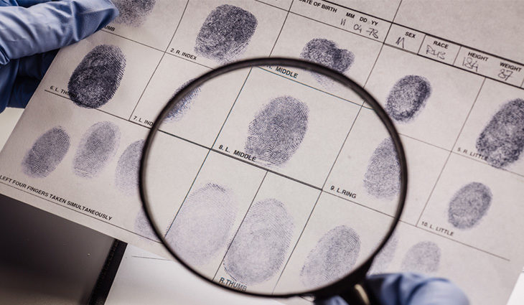
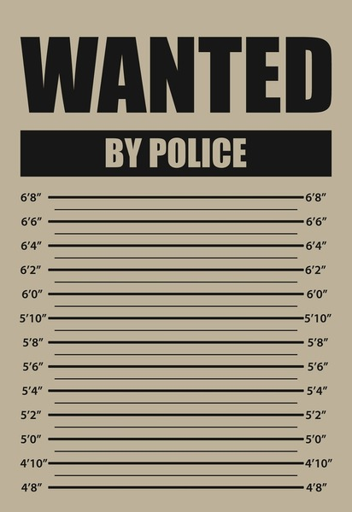
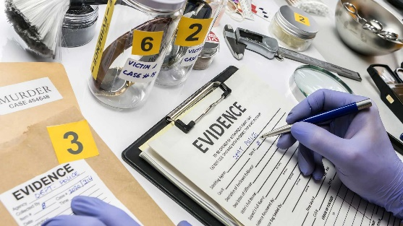
WJEC Applied Diploma in Criminology
This booklet is designed to introduce you to the applied diploma in Criminology and some of the topics you will be studying.
Work through the booklet and complete the tasks.
You will need to have a copy of the tasks you have completed with you on your first lesson in September.
If you have any questions please contact:
Miss Smith: c.smith@scacademy.co.uk
Miss Newton: c.newton@scacademy.co.uk

Slide 2
What will I be studying?
Criminology is the scientific study of crime and criminal behaviour. Drawing from other subjects like sociology, psychology and law, criminology examines the complexities of crime, looking at what motivates criminals and the impact their actions have on victims and communities.
Year 12
Unit 1: Changing awareness of crime Unit 2: Criminological theories
Year 13
Unit 3: Crime scene to courtroom Unit 4: Crime and punishment

Slide 3
Task 2: All about hate crime•
TASK 1: WHAT DOES CRIME LOOK LIKE IN YOUR AREA?
You will already know that different areas of the UK will have different crime rates but did you know that different areas have different types of crime? Think about the difference between urban, built up areas compared to rural areas – what would the difference in types of crime be?
Use the link below to look at the amount and types of crime that occur in your area. What is the most common type of crime? How often has crime occurred in the last year? Is there a pattern? E.g. does crime increase in certain months of the year?
Then compare your findings to 2 other areas – one that is a city centre e.g. Birmingham or London, and one that is more rural e.g. Pattingham (outskirts of Wolverhampton). Is there a difference in the number and types of crimes committed in each of these areas compared to where you live?
https://www.police.uk/pu/your-area/
Use the dropdown menu to see the different types of crime!
TIP: When looking at crime data, just stick to the last year.

Slide 4
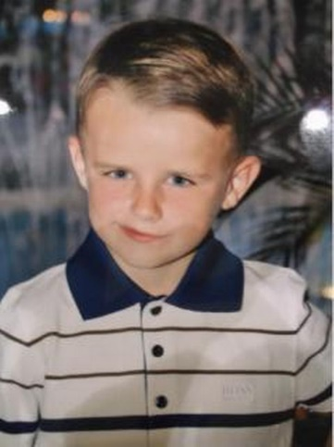
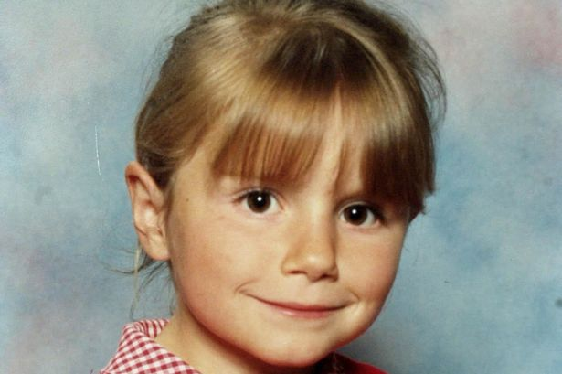
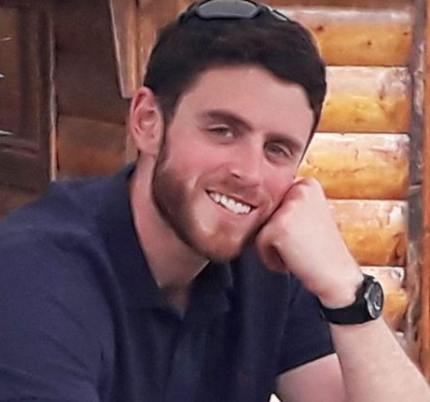
Task 2: All about hate crime•
TASK 2: CAMPAIGNS FOR CHANGE
A big focus of Unit 1 in Criminology is looking at how laws, policies and procedures have changed over time. You will also get the chance to plan your own campaign. It therefore makes sense for us to start the course with a good set of knowledge about what existing campaigns are out there. Choose two of the following campaigns to research and makes notes using the criteria below.
CAMPAIGNS
Sarah’s Law
Double Jeopardy Law
Dignity in Dying
Snowdrop Campaign
Slow Down for Bobby
Harper’s Law
CRITERIA
Why did this campaign start?
What was the aim of the campaign? What did they want to achieve?
How did they do it? What methods were involved? i.e. TV interviews, petitions
Was the campaign successful? Has it changed law/policy/procedure? Did it raise awareness?

Slide 5
TASK 3: APPROACHES IN CRIMINOLOGY
Within criminology there are different approaches or perspectives that try to explain criminal behavior.
Your third task is to research and produce a fact file on each of the perspectives. In each fact file you should include:
Assumptions of each perspective i.e. how do they explain criminal behavior/what causes criminal behavior?
Key thinkers that support each approach
Key terminology
Crimes that would be associated with each perspective/theory
Your fact files can be digital, or paper based.
Eysenck’s criminal personality
Marxist perspective
Merton’s Strain theory
Interactionism (labelling theory)
Social learning theory

Slide 6
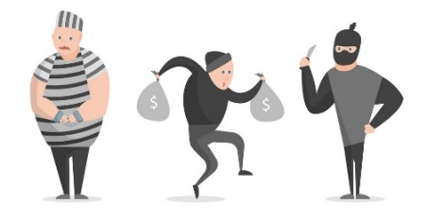
CRIMINOLOGY IN THE MEDIA
Did you know that approximately 20% of films are crime related and around 46% of media reports focus on violent/sexual crime? With this mind, it makes sense that some people feel that crime is all around them. This task will widen your knowledge of the different ways crime is portrayed in the media. Pick whichever of the following documentaries to watch as part of your introduction to criminology. Be sure to make a note of key events.
NETFLIX
Amanda Knox
Disappearance of Madeline McCann
When they see us
Confessions of a killer: The Ted Bundy Tapes
Making a Murderer
The Innocence Files
Evil Genius
The People vs OJ Simpson
Staircase
The Trials of Gabriel Fernandez
Killer Inside: The Mind of Aaron Hernandez
13th
Abducted in plain sight
American Murder (The Family Next Door)
YOUTUBE
Belmarsh: Inside Britain’s Toughest Prison
(https://www.youtube.com/watch?v=mLRBpf-Ws6k)
Murder At Columbine High School
(https://www.youtube.com/watch?v=D9mUpUHk3nE)
Hillsborough: anatomy of a disaster
(https://www.youtube.com/watch?v=PYNeoTXe-SE)
Defending Violent Criminals
(https://www.youtube.com/watch?v=Q15bAd8s08I)
Dr Death: Britain’s Biggest Serial Killer
(https://www.youtube.com/watch?v=3-KVuVjmjmU)
Michelle Carter – Can Words Kill
(https://www.youtube.com/watch?v=MfAG4O7ojxE)
Myra Hindley – Britain’s Most Hated Woman mmm(https://www.youtube.com/watch?v=NQ8eKB5fJRk)
The Boys Who Killed a Child (Jamie Bulger)
(https://www.youtube.com/watch?v=TrkQe4tyJnQ)

Slide 7
Summer learning log
Record here any additional reading/viewing you are undertaking in order to show what you have been completing to prepare you for the course. Use the recommendations on the previous pages for ideas of what to watch/read
Date | Title | Summary of content | My thoughts

Slide 8
Summer learning log
Record here any additional reading/viewing you are undertaking in order to show what you have been completing to prepare you for the course. Use the recommendations on the previous pages for ideas of what to watch/read
Date | Title | Summary of content | My thoughts

Slide 9
Useful resources
To help you on your way…
Websites:
WJEC Applied Diploma in Criminology Specification-
https://www.wjec.co.uk/qualifications/criminology-level-3/#tab_keydocuments
Tutor2U - https://www.tutor2u.net/criminology
It is also recommended that you take an active interest in the news and what is going on around you in the wider world as a lot of the concepts and ideas covered in lessons will relate to what is going on. The ability to be able to draw upon contemporary examples will also help illustrate your application and understanding skills which will be vital in order for you to achieve the higher grades in this subject.
For your first lesson you will need to have the following…..
A lever arch folder
A set of dividers
Your own lined paper
Plastic wallets if you want to use them
A pencil case with the usual things including highlighters and a green pen
A copy of this booklet and all the tasks you have completed
If you have any questions please get in contact with us via email.
We look forward to seeing you in September!

