Slide 1
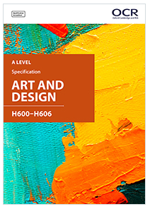
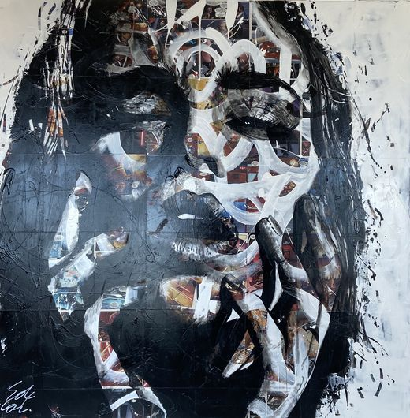
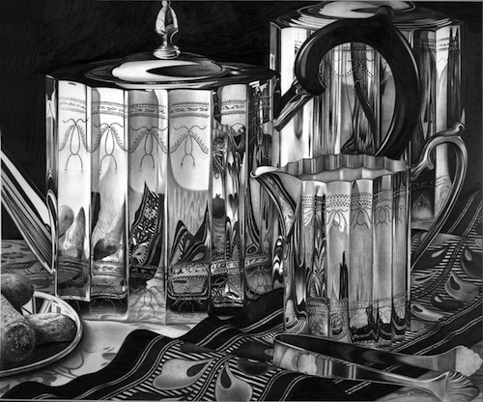
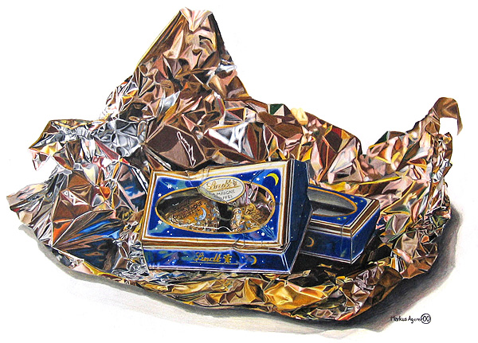
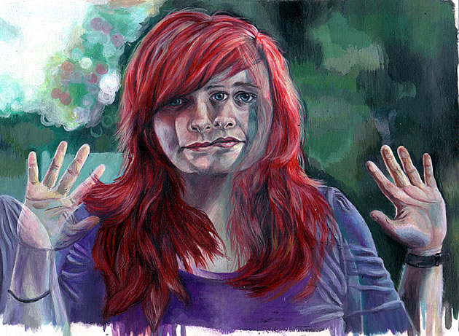
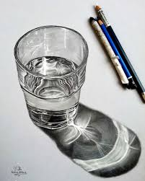
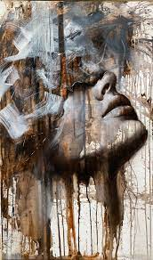
https://www.ocr.org.uk/qualifications/as-and-a-level/art-and-design-h200-h600-from-2015/

Slide 2
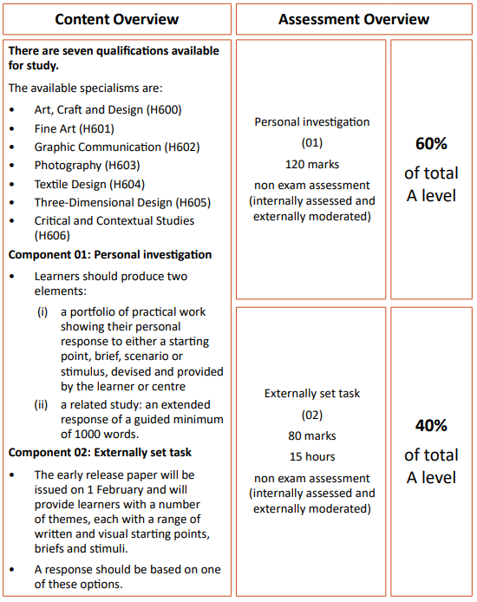
Learners are required to establish through this written and, where appropriate, illustrated component, the related context in which their chosen practical portfolio exists.
This may be established by exploring the genre, subject matter, movement or historical framework of the overarching starting point, course of study or theme selected.
The aim of the related study is to enable learners to develop their ability to communicate their knowledge and understanding of art historical movements, genres, practitioners and artworks, considering the way that these change and evolve within chronological and other frameworks. It also builds their understanding of the relationship between society and art: art historical terms, concepts and issues; methods of researching, investigating and analysing; and how works are interpreted and evaluated.
The related study should be separate and clearly identifiable from the contextual research embedded in the development of the practical portfolio.
Learners should also highlight their own work and clearly distinguish it from collected or transposed material. Learners may produce the related study in an appropriate form of which the following are some examples: an illustrated essay, digital presentation/ blog, illustrated study sheets or written report.
It is a requirement of the related study that all source material and research are listed and acknowledged in a bibliography and should be clearly identifiable in the work presented for assessment.

Slide 3
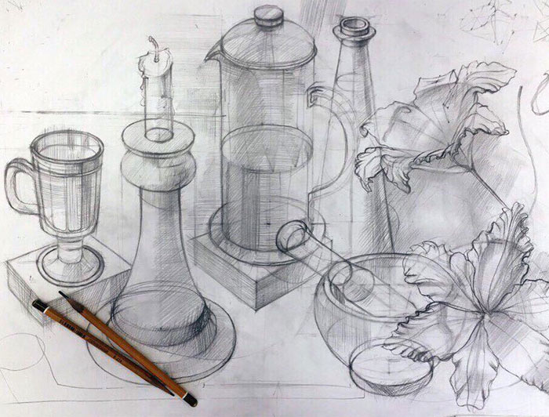
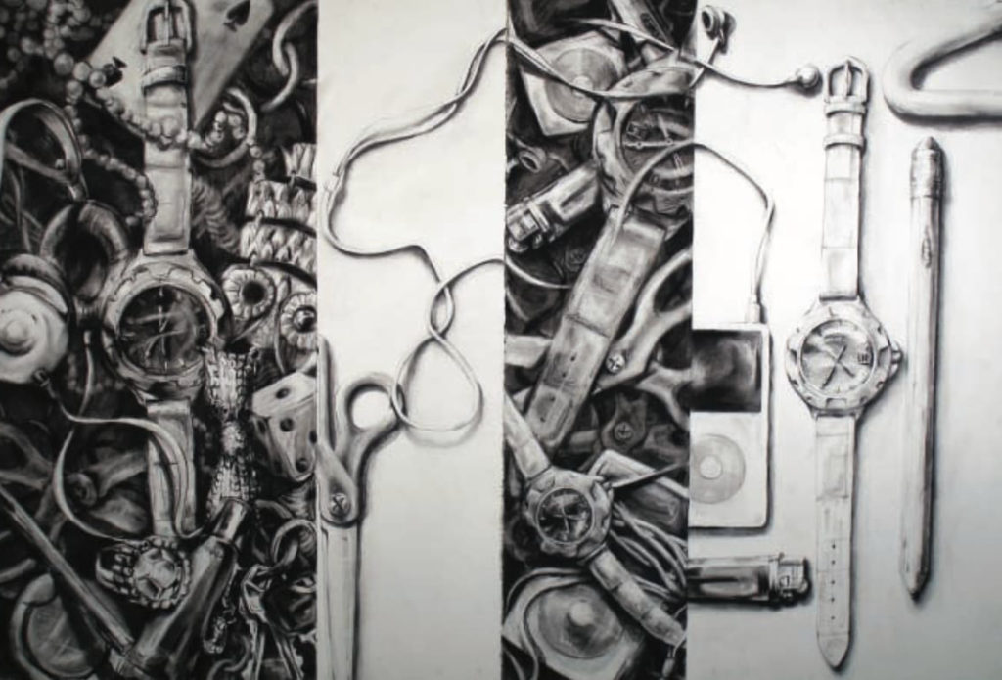
Create a piece of art from the still life set-up in the centre of the room.
You have a range of dry media to choose from and around 2 hours to complete the task.
Your drawing must be a minimum of A3.

Slide 4
Task:
Select three artists of your choice and complete the following tasks;
Produce an artist copy for each of your artists, you should consider the media, materials and techniques that your artists use in their work.
For each of the artists you have selected use the supporting information to write a set of annotations, one for each of your artists.

