Slide 1
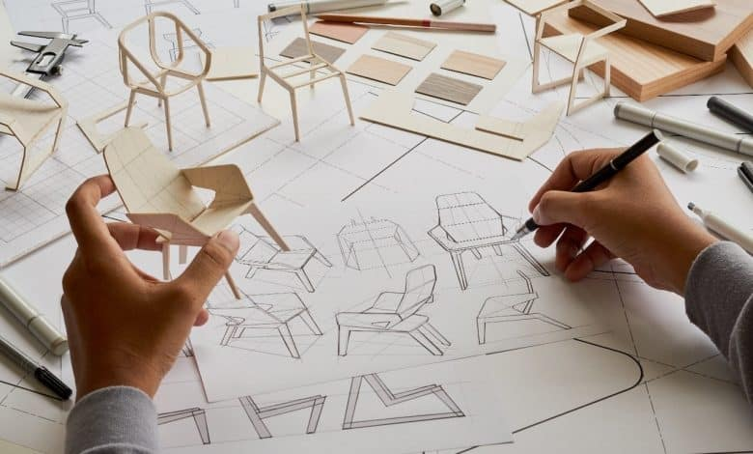
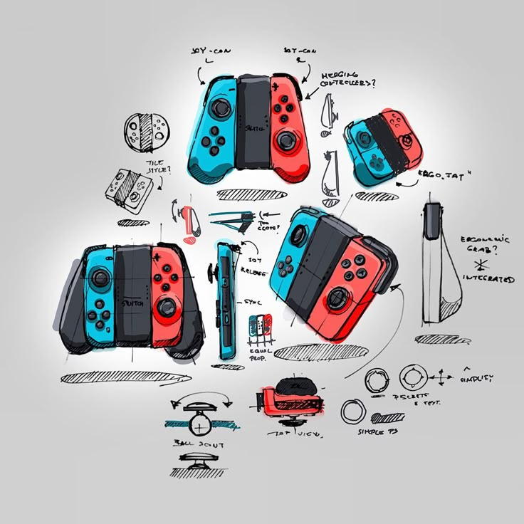
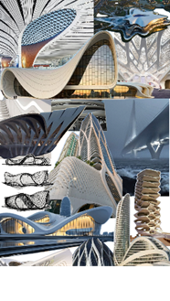
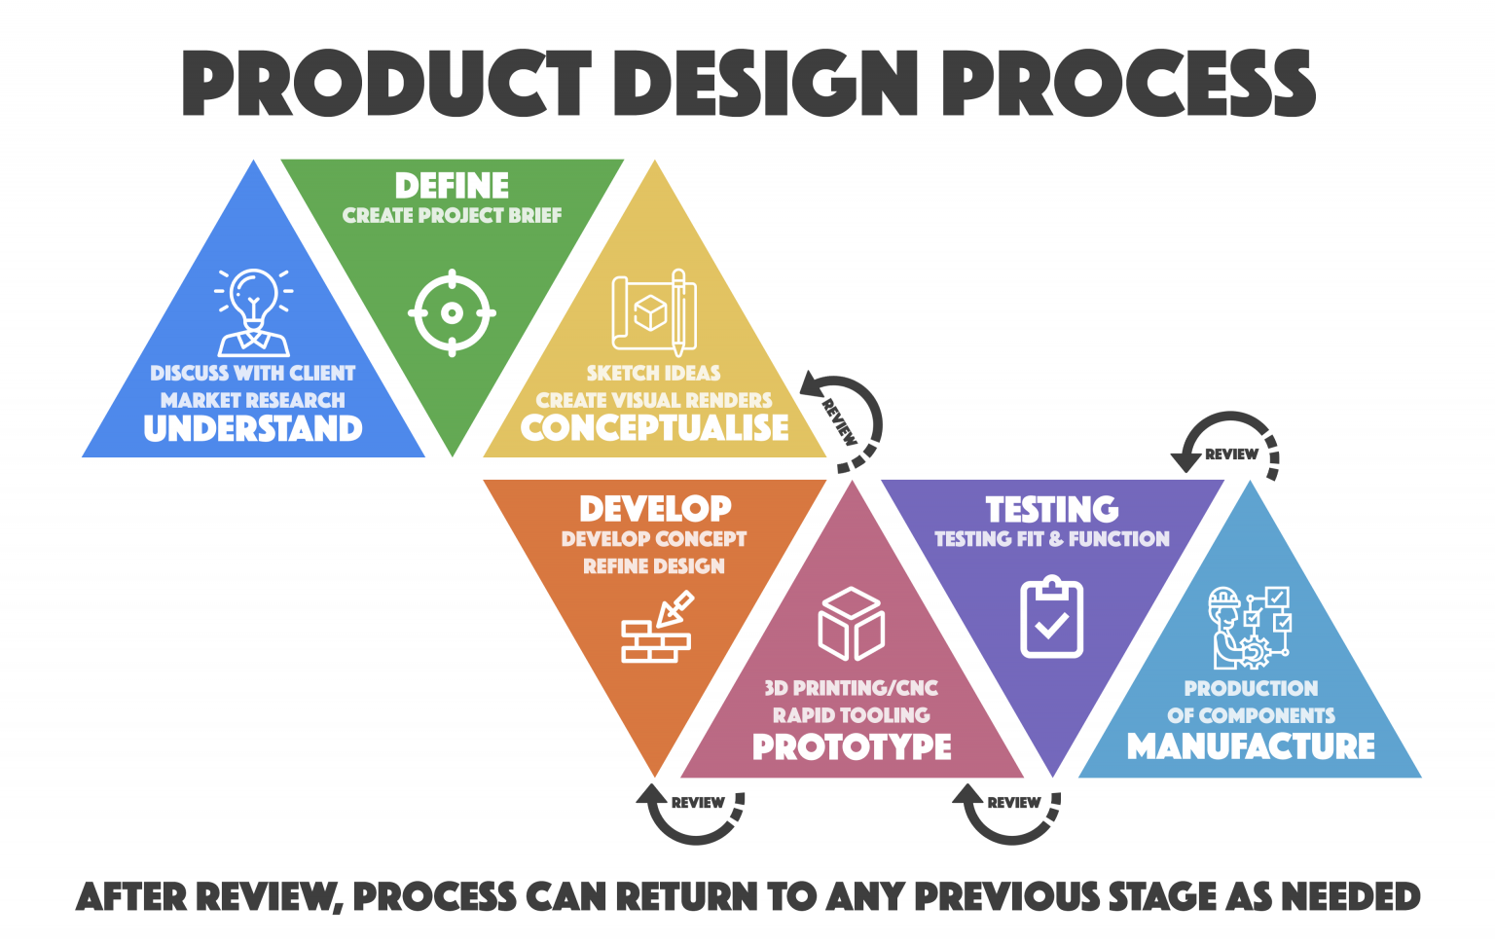
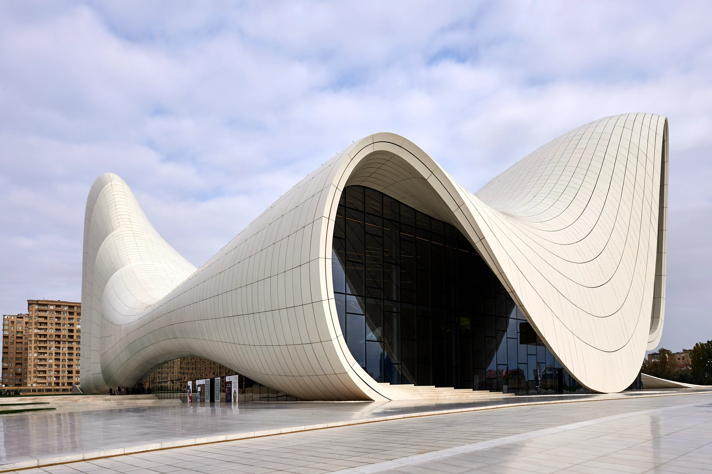
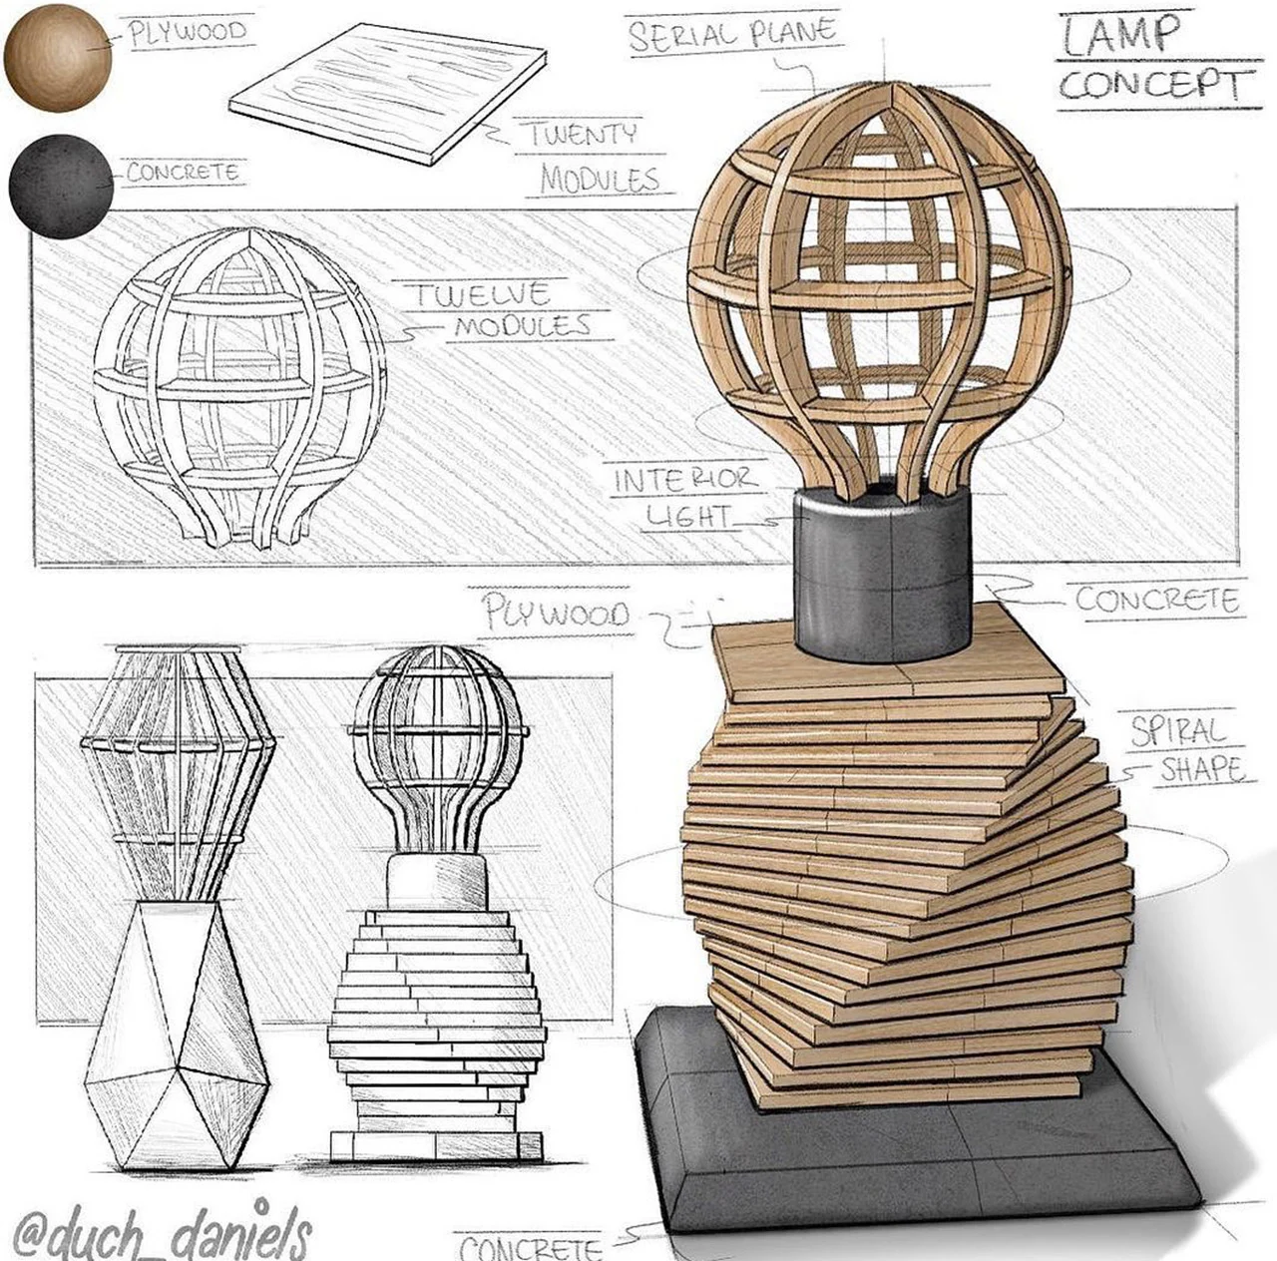
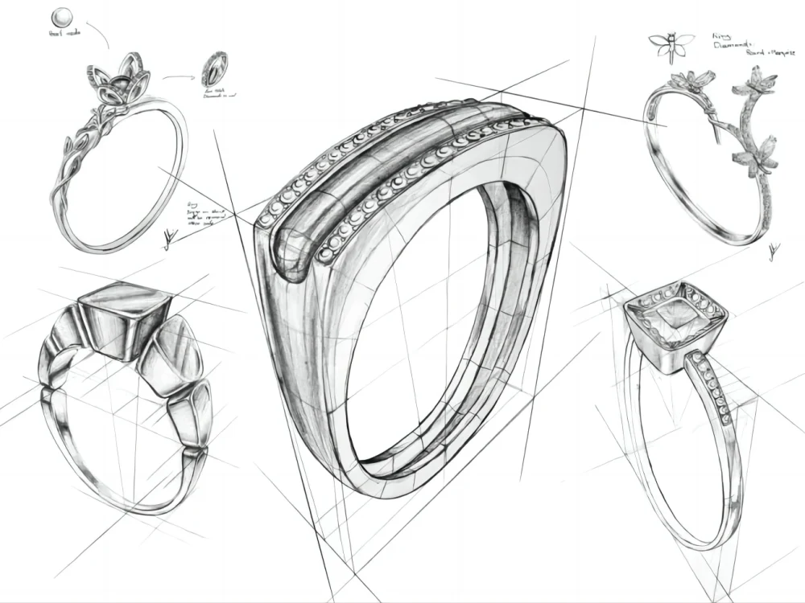
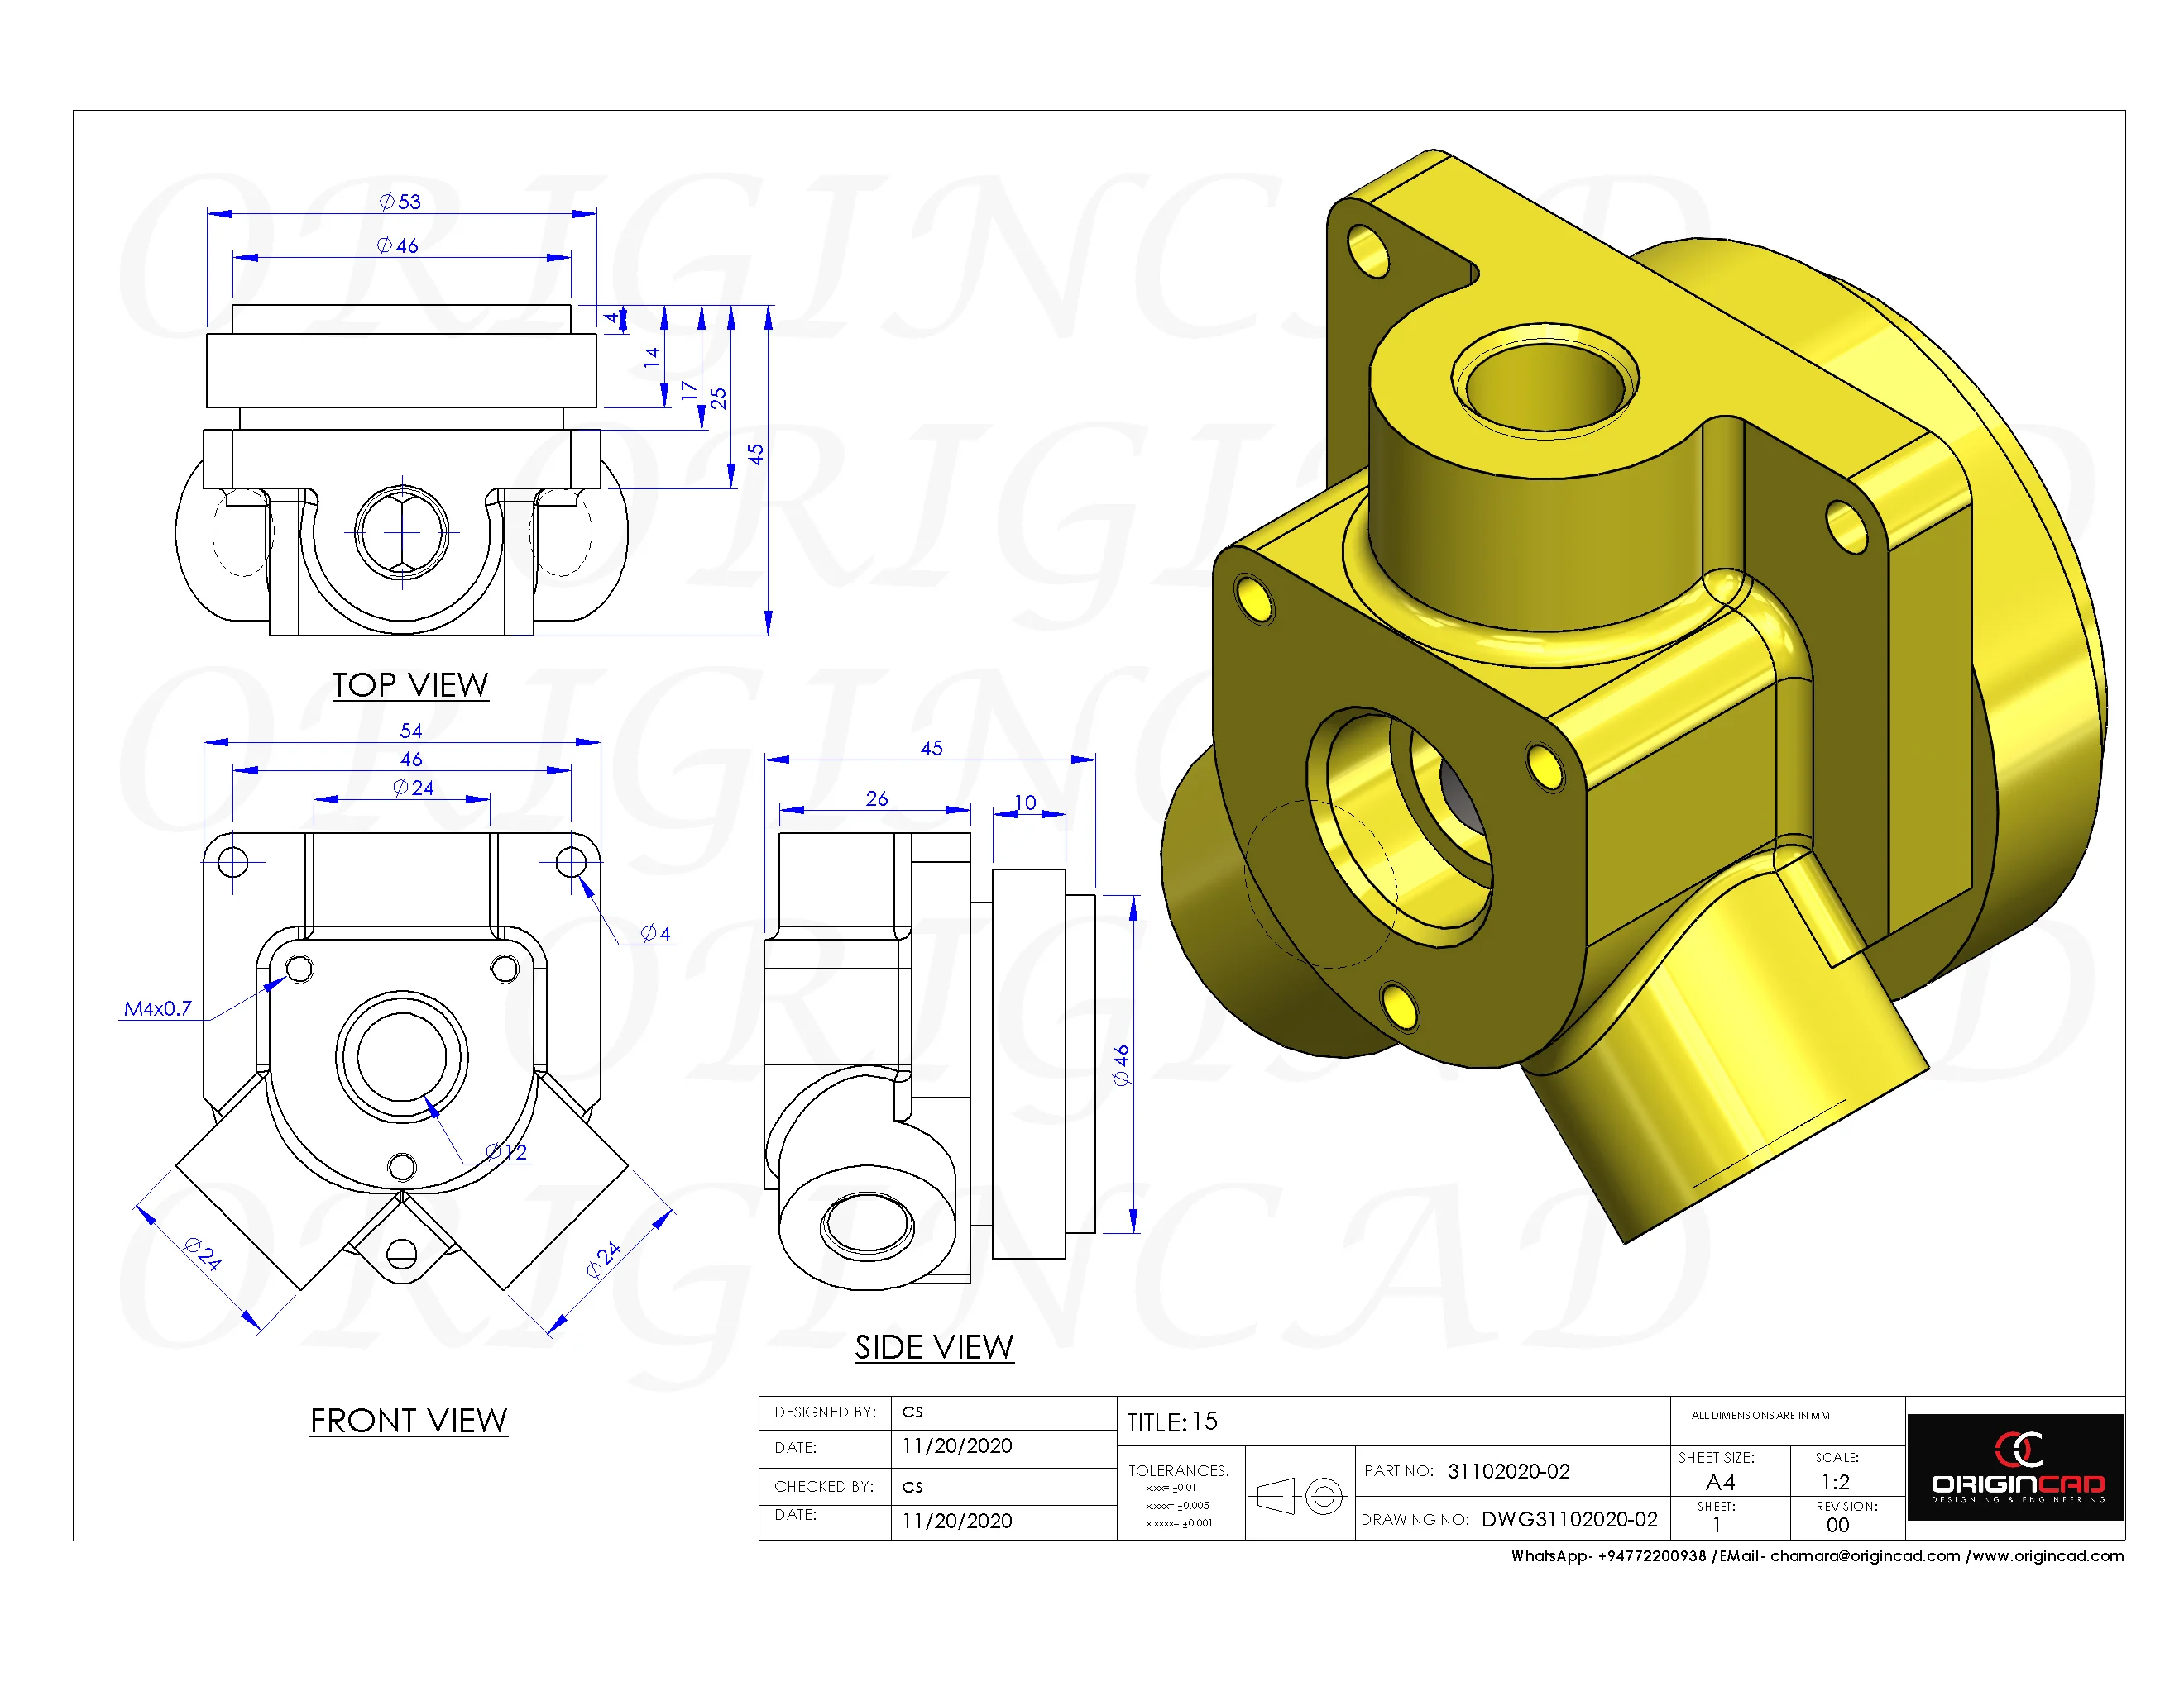
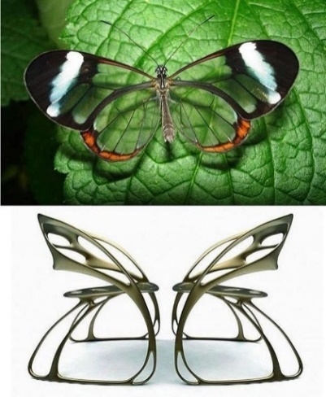
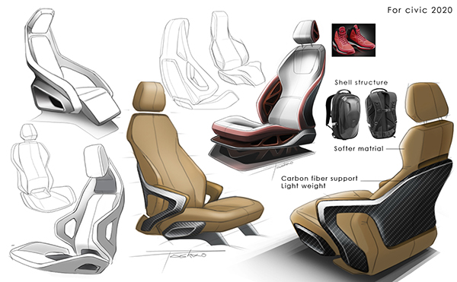
A LEVEL 3D Design
Design is the fundamental soul of a human-made creation that ends up expressing itself in successive outer layers of the product or service.
Steve Jobs
This booklet is designed to introduce you to 3D Design at post 16.
Work through the booklet and complete the tasks.
You will need to have a copy of the tasks you have completed with you on your first lesson in September.
If you have any questions, please contact:
Mrs Liddell: T.Liddell@scacademy.co.uk

Slide 2
What will You be studying?
As Technology evolves, 3D Design is becoming even more essential. From 3D printing to virtual reality, the demand for skilled 3D designers is growing fast. It’s a future-forward skill that keeps you at the cutting edge.
You will produce practical and critical/contextual work in one or more areas of study, for example, Product Design, 3D digital Design (CAD), Environmental Design, Architectural Design, Jewellery/ body ornament and Construction for television, game or film.
3D Design is used in:
Movies and animation (think Pixar or Marvel)
Video games (from indie gems to AAA titles)
Architecture and interior design
Product design and engineering
Virtual and augmented reality
Medical imaging and simulations
Studying it opens doors to a wide range of industries.
Course Overview
Component 1=
Personal Investigation (NEA)
60%
You will develop work for a personal investigation into an idea, issue, concept or theme supported by written material.
Total marks= 96
Component 2=
Externally Set Assignment
40%
You will produce personal work in response to one of eight exciting starting points
Preparatory period + 15hr’s supervised time.
Total marks= 96

Slide 3
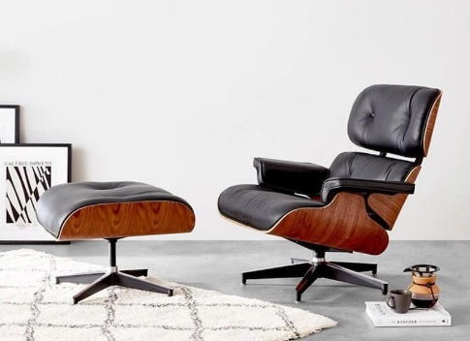
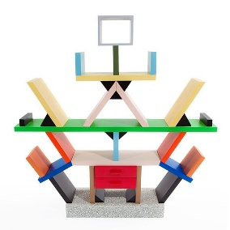
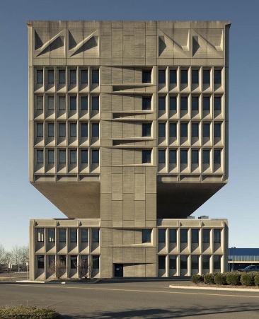
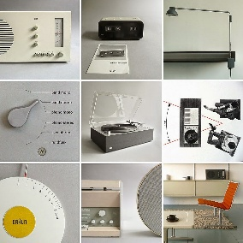
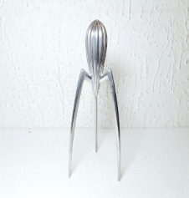
Task Overview.
You will research a well-known designer or design movement and use their work as inspiration to develop your own original 3D Design ideas for a futuristic product to be used or worn in 2025. You’ll also explore and apply key design principles throughout the process.
Choose one of the following:
Zaha Hadid
Charles and Ray Eames
Dieter Rams
Marcel Breuer
Philippe Starck
Bauhaus Movement
Memphis Group.
Your research should include:
-A short biography and context
-Their design style and approach
-Key materials, forms and techniques they use
-Examples of at least 3 of their works (with images)
-Reference to design principles (see next page)
-Your personal opinion: What do you like or find interesting?
Task 1: Research a Designer
or Design Movement
!
.
Present your research as a mood board or visual research page
in PowerPoint.

Slide 4
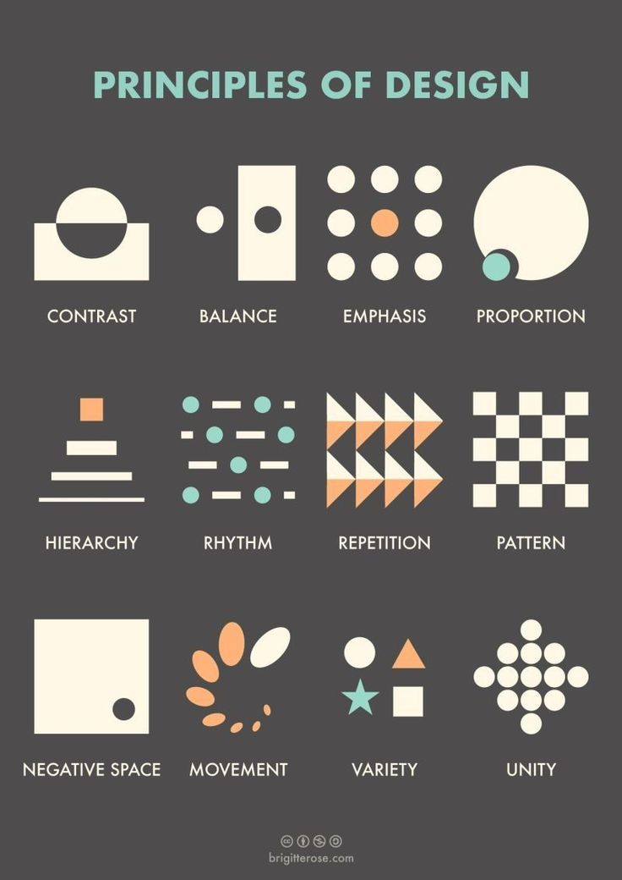
Design Principles to Explore and Apply
Include how the designer or movement uses at least 3 of the following principles in their work.
Form and Function- Is it sculptural? Practical? Both?
Balance- Symmetry vs asymmetry.
Contrast- Use of different materials, shapes or textures
Rhythm and Repetition- Patterns or repeated shapes.
Proportion and Scale- Relationship between elements.
Unity and Harmony- Do all parts work well together?
Emphasis- Focal points or standouts features.

Slide 5
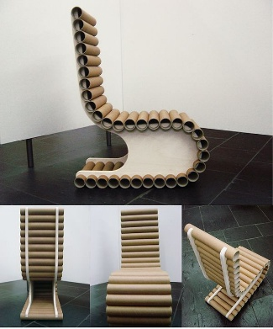
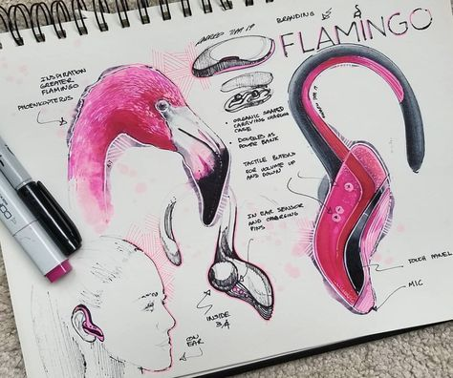
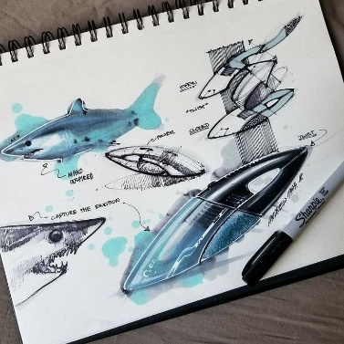
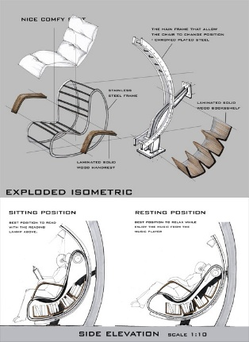
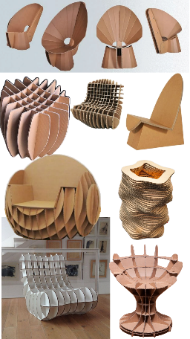
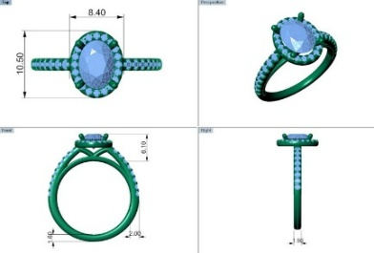
Task 2: Design Development
Create your own original Futuristic 3D Design inspired by the
designer or movement you researched.
Your design could be:
A piece of furniture.
A household product.
A gaming gadget
A lighting design
A piece of jewellery
A small architectural concept.
Include:
Initial thumbnail sketches with annotation
Developed drawings showing how your idea developed.
Reference to design principles in your work.
Note any annotations explaining (optional)
Final design drawings or model (can be 3d sketches, digital
mock-up (CAD) or cardboard prototype)

Slide 6
Suggested Extension Task:
Evaluation Task- Reflecting on your Design
Use the questions below to write an evaluation of your project
(approx. 300-500 words). This can be typed or handwritten.
1: How did your chosen designer or movement
influences your work?
What element did you borrow or adapt (materials,
shapes, colours, etc)?
2: Which design principles were most important in your final
Design?
For example, did you focus on balance, harmony, contrast?
3: What worked well in your design process?
Consider your research, development, creativity, or presentation.
4: What would you improve or change if you did it again?
Be honest about any challenges you faced.
5:How well does your design meet its intended purpose or Function?
-Is it purely aesthetic, functional, or both?
6: How has this project helped understand 3D design better?
- Reflect on skills, techniques, and knowledge gained.

Slide 7
Useful Resources:
To help you on your way…
Websites:
AQA Official Specification – 3D Design
The official source for the AQA A-level Art & Design (3D Design) specification.
Includes assessment objectives, content breakdown, and examples of areas of study.
CAD software/ APPS:
SketchUp Free
A browser-based 3D modeling platform used in architecture and product design.
Great for exploring proportion, scale, and spatial design
Fusion 360 – Autodesk A professional-grade 3D CAD, CAM, and CAE tool.
Free for students and educators.
Ideal for advanced modeling, engineering simulations, and product design.
Places to Visit:
Design Museum – Learning Resources
Offers case studies, design challenges, and insights into professional design processes.
Supports contextual understanding and critical analysis
Pitt Rivers Museum – Oxford A world-renowned museum of anthropology and archaeology.
Excellent for exploring form, function, and cultural design across time and geography.
Great for contextual studies and sketchbook research.
For your first lesson you will need to have the following…..
1; To hand in your presentation and designs.
2. An A3 Sketch book
3. Drawing equipment.
We look forward to seeing you in September!

